Slide 1
ONLINE RESUME BUILDER
Project by: Roshni Verma.
Guide by: Ms.Arpita Roy
(Quality Quester)

Slide 2
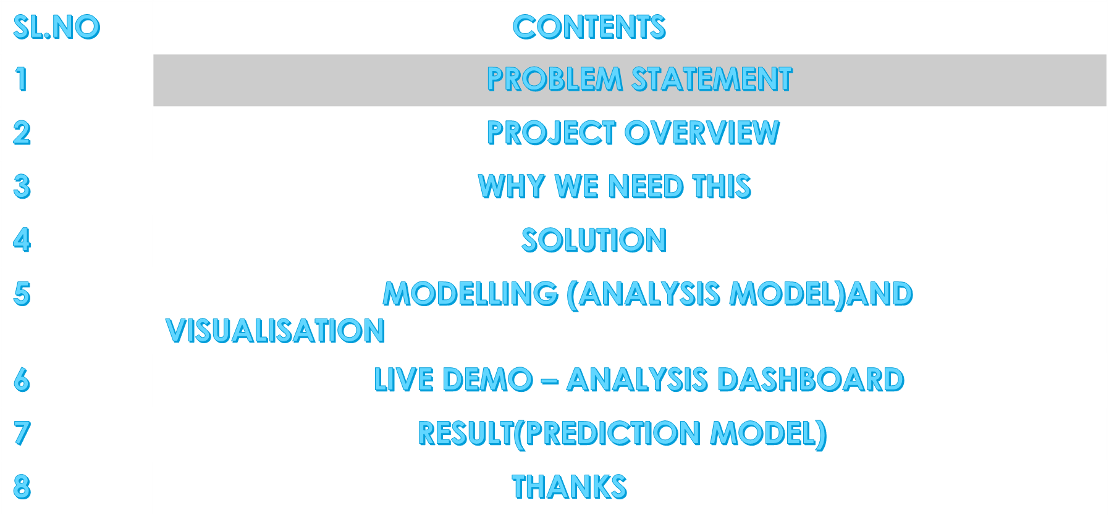
AGENDA

Slide 3
INTRODUCTION
This is an application that helps us to build a resume for individuals. The system is malleable for creating an appropriate resume according to qualification by reducing the need of thinking. Usually individuals get confused while creating a resume especially fresher’s who are looking for new jobs. They are not much clear about what things and information must be included in a resume. This application will provide an easy way of developing a resume that will look like a professional resume.

Slide 4

The existing system is creating resumes manually either by using word or Google doc so there are some issues with the existing system.

Slide 5
Solution
It helps users to focus on content.
In application creation and modification are very simple and user-friendly tasks.
It saves time for users .

Slide 6
KEY FEATURE
This app allows users to login/sign.
This would be facilitating the students to make and print their resumes in a proper format.
This app automates the process of creating resumes by simply taking information as input from the us.
Saves time.

Slide 7
MODELLING &VIRTUALISATION
USER
USER
Manage details
YES
Already base on account
Log in
Log in
Create resume
Log out
NO
Download
resume
RE
Register
SUCCESSFUL

Slide 8
Thank You
Credit Goes to:
• Mentor : Ms.Arpita Roy
• Youtube channel
• Google

